Slide 1


Davide Presti
August 1, 2024

Slide 2

Outline
Executive Summary
Introduction
Methodology
Results
Conclusion
Appendix

Slide 3

Executive Summary
Summary of methodologies
Data Collection API
Data Collection with Web Scraping
Data Wrangling
EDA with SQL
EDA with Visualization
Interactive Visual Analytics with Folium
Machine Learning Prediction
Summary of all results
Exploratory Data Analysis result
Interactive analytics in screenshots
Predictive Analytics result

Slide 4

Introduction
Project background and context
We will predict if the Falcon 9 first stage will land successfully. SpaceX advertises Falcon 9 rocket launches on its website, with a cost of 62 million dollars; other providers cost upward of 165 million dollars each, much of the savings is because SpaceX can reuse the first stage. Therefore if we can determine if the first stage will land, we can determine the cost of a launch. This information can be used if an alternate company wants to bid against SpaceX for a rocket launch.
Problems you want to find answers
Which factors influence the success of the first stage landing?
What is the rate of successful landings?

Slide 5

Section 1

Slide 6

Methodology
Executive Summary
Data collection methodology:
Collecting the data through the Space X API and web scraping from Wikipedia.
Perform data wrangling
Application of One-Hot encoding and data cleansing for use in ML models.
Perform exploratory data analysis (EDA) using visualization and SQL
Finding patterns and insights through data visualization techniques.
Perform interactive visual analytics using Folium and Plotly Dash
Using Dash and Folium to perform interactive visualizations.
Perform predictive analysis using classification models
Build and evaluate classification models.

Slide 7
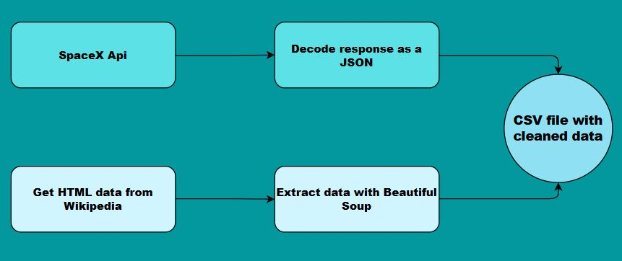
Data Collection
Data was gathered through the Space X API and Wikipedia web scraping, then extracted, decoded and cleaned and finally exported to a CSV file.

Slide 8
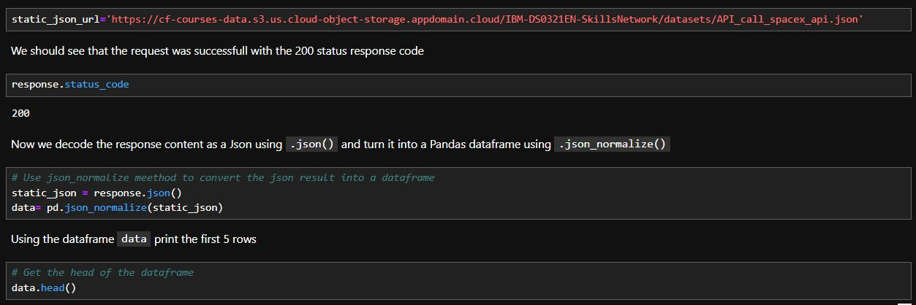
GitHub URL of the completed SpaceX API calls notebook: (It’s a hyperlink, just click on it)
Data Collection – SpaceX API
First we request and parse the SpaceX launch data using the GET request which is then converted into a Pandas dataframe.
We filter the dataframe to only include Falcon 9 launches.
Then we perform some data wrangling to clean the data.

Slide 9
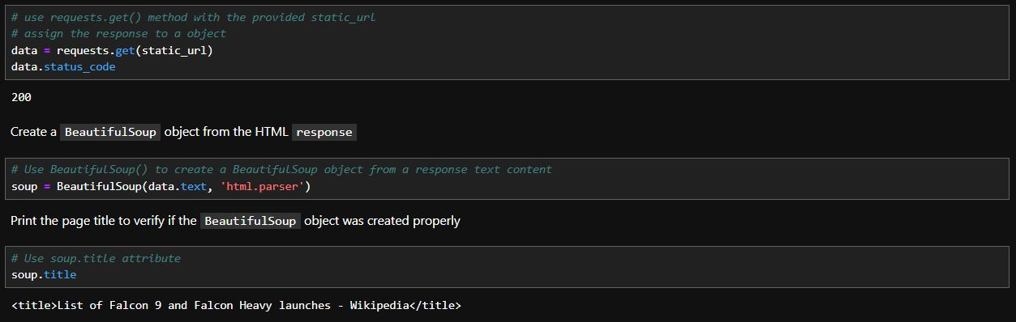
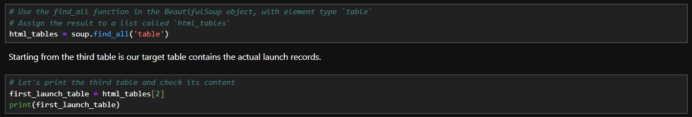
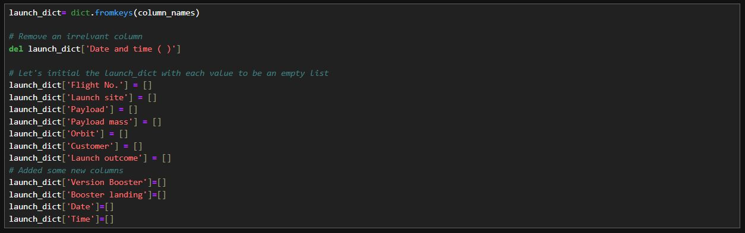
GitHub URL of the completed Webscraping notebook: (It’s a hyperlink, just click on it)
Data Collection - Scraping
First we request the Falcon9 Launch Wiki page from its URL.
We extract all column/variable names from the HTML table header.
Then we create a data frame by parsing the launch HTML tables.

Slide 10
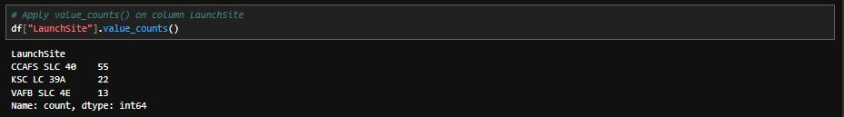

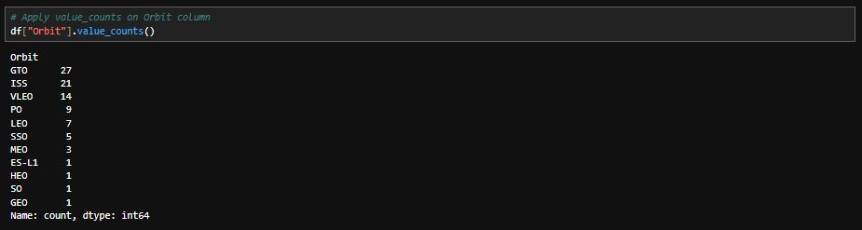
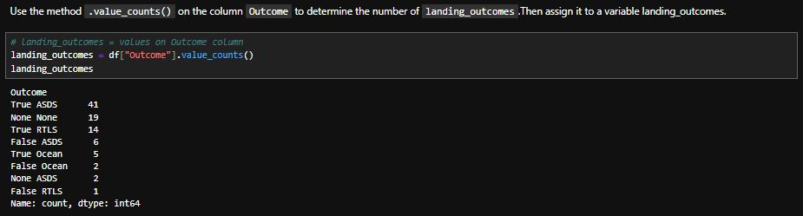
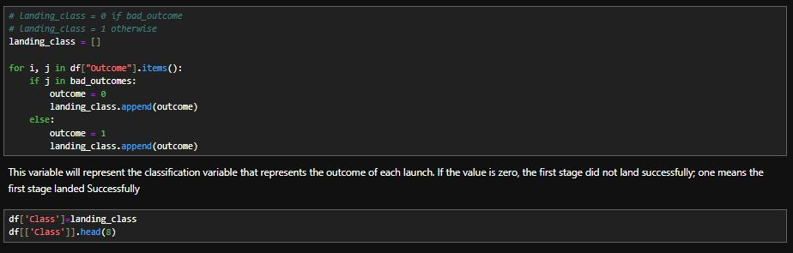
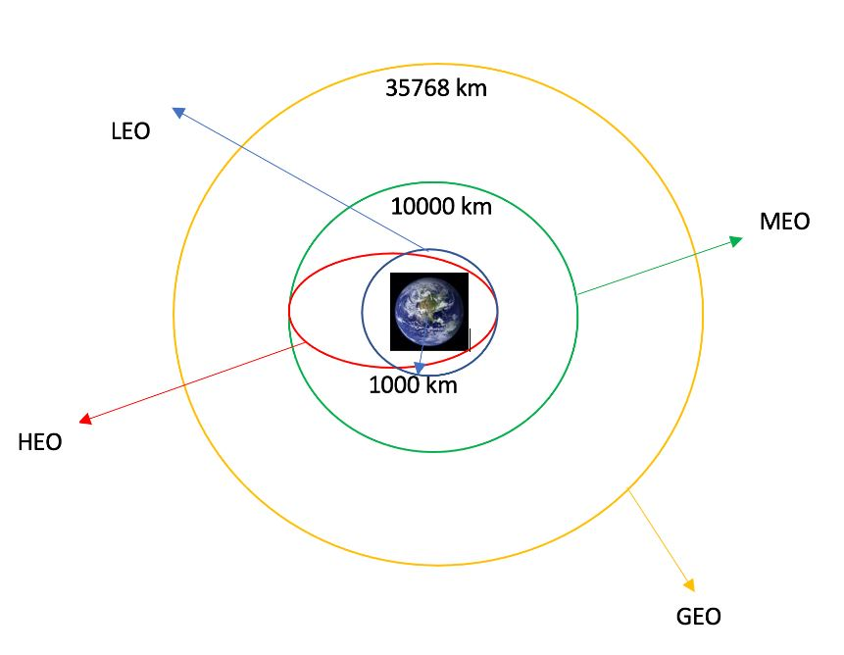
Data Wrangling
We calculate the number of launches on each site.
We calculate the number and occurrence of each orbit.
We calculate the number and occurence of mission outcome of the orbits.
Finally we create a landing outcome label from Outcome column.
GitHub URL of the completed Data Wrangling notebook: (It’s a hyperlink, just click on it)

Slide 11
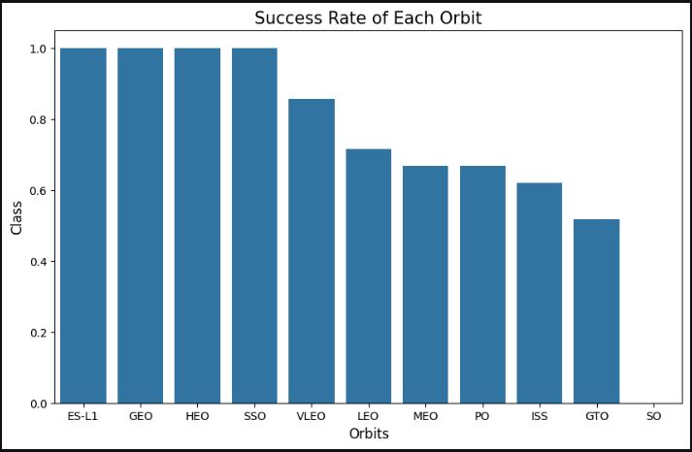
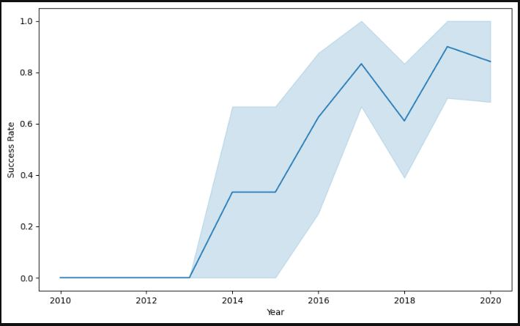
EDA with Data Visualization
In the first image, we display the relationship between success rate of each orbit type using a bar chart.
In the second image, we visualize the launch success yearly trend using a line chart.
GitHub URL of the completed EDA with Data Visualization notebook: (It’s a hyperlink, just click on it)

Slide 12
We applied EDA with SQL queries to obtain meaningful information on the data. Here are some examples:
EDA with SQL
We display the names of the unique launch sites in the space mission:
We display 5 records where launch sites begin with the string 'CCA’:
We display average payload mass carried by booster version F9 v1.1:
GitHub URL of the completed EDA with SQL notebook: (It’s a hyperlink, just click on it)
We list the total number of successful and failure mission outcomes:

Slide 13

Build an Interactive Map with Folium
We marked all launch sites on a map using site's latitude and longitude coordinates.
We marked the success/failed launches for each site on the map.
We calculated the distances between a launch site to its proximities.
Thanks to the insights we have gained about launch sites, we can conclude that:
They are in close proximity to railways, which is good because it allows transporting the heavy components needed to assemble the rockets.
They are in close proximity to highways, which allows proper communication so that personnel can get there easily.
They are in close proximity to coastline to ensure that no debris falls on populated areas in case of failures.
They keep certain distance away from cities in order to mitigate risks in the event of a serious rocket failure.
GitHub URL of the completed Launch Sites Location Analysis notebook: (It’s a hyperlink, just click on it)

Slide 14
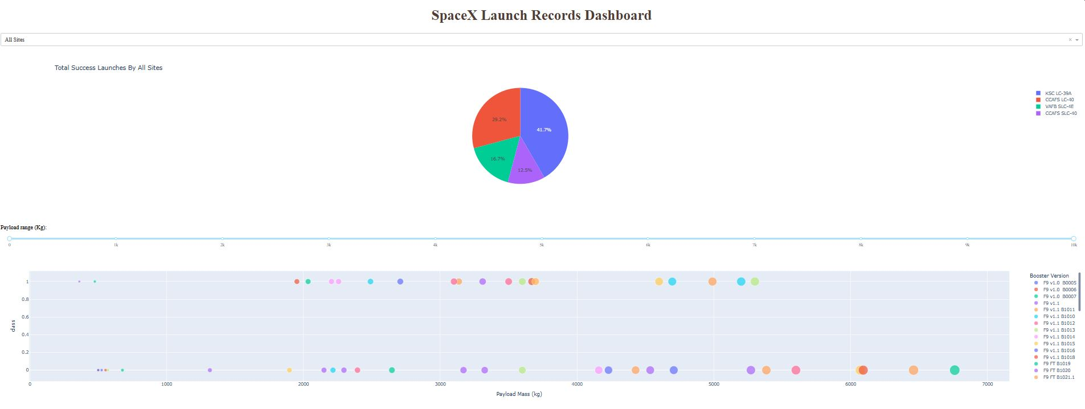
Build a Dashboard with Plotly Dash
We created a dashboard with Plotly Dash, pie charts showing the total launches for a given site and a scatter plot showing the relationship with the outcome and the payload mass for the different versions of the booster.
GitHub URL of the completed SpaceX Dash App: (It’s a hyperlink, just click on it)

Slide 15

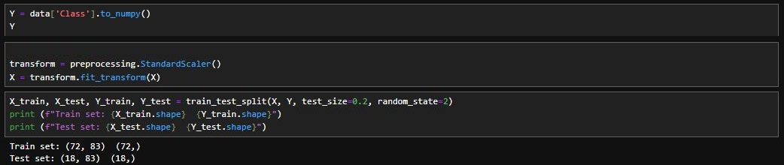
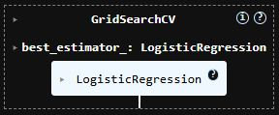
Predictive Analysis (Classification)
We used numpy and pandas, transformed the data and then split it for training and testing.
We have created different machine learning models using GridSearchCV.
Finally we found the best performing method.
GitHub URL of the completed Machine Learning Prediction notebook: (It’s a hyperlink, just click on it)

Slide 16
Results
Exploratory data analysis results
Interactive analytics demo in screenshots
Predictive analysis results

Slide 17

Section 2

Slide 18
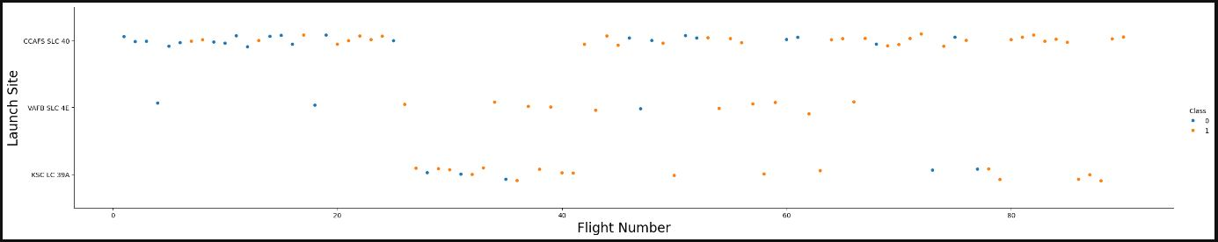
Flight Number vs. Launch Site
INSIGHTS:
CCAFS SLC 40 and KSC LC 39A have a higher number of flights compared to VAFB SLC 4E.
In general, the higher the number of flights, the higher the success rate.

Slide 19
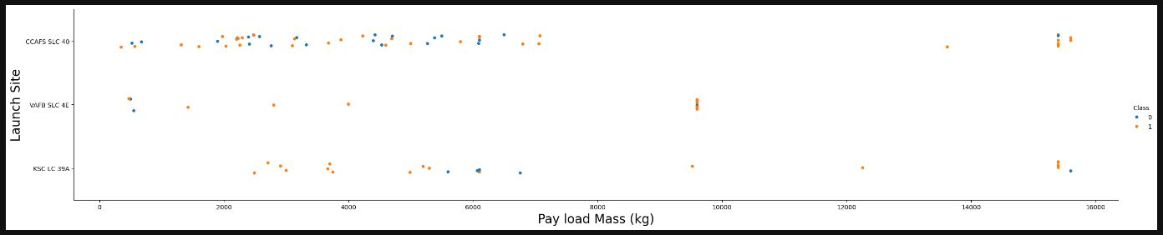
Payload vs. Launch Site
INSIGHTS:
The highest failure rate is recorded for payload masses between 4,000 kg and 6,000 kg.
Payload masses over 8,000 kg have a higher success rate.
In general, the higher the payload, the higher the success rate.

Slide 20

Success Rate vs. Orbit Type
INSIGHTS:
The top five orbits are ES-L1, GEO, HEO, SSO and VLEO.
SO orbit has no success rate.

Slide 21
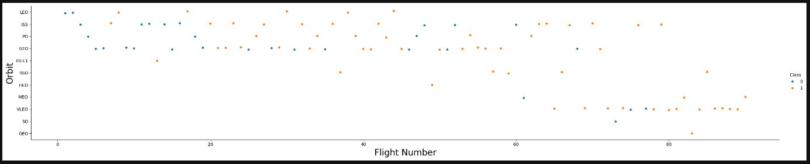
Flight Number vs. Orbit Type
INSIGHTS:
LEO orbit success rate is related to the number of flights, as the number of flights increases the success rate increases.
SO orbit has no success rate.
There is an increasing trend of launches from VLEO orbit in recent years.

Slide 22
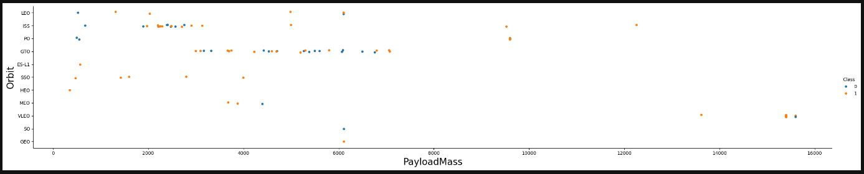
Payload vs. Orbit Type
INSIGHTS:
Payload mass between 3000 and 8000 is affecting GTO orbit.
With heavy payloads, the success rate is higher in ISS, LEO and PO orbits.

Slide 23
Launch Success Yearly Trend
Since 2013 the success rate had a massive increase until 2018 which decreased a bit, but from 2019 onwards it continued to increase like never before.

Slide 24
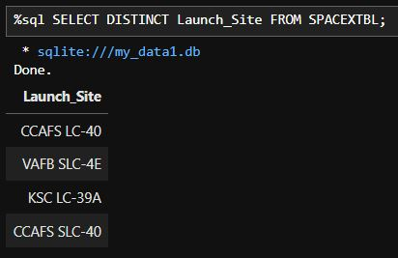
All Launch Site Names
We can get the unique launch site names by using the DISTINCT keyword.

Slide 25
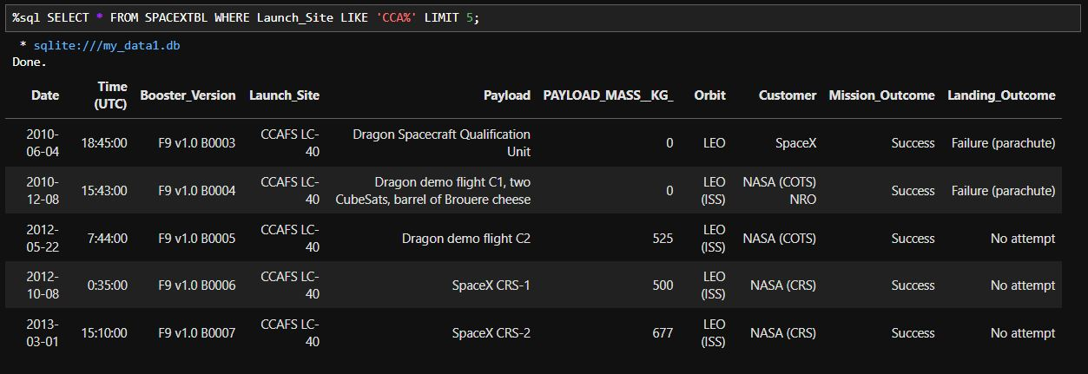
Launch Site Names Begin with 'CCA'
We can get 5 launch sites starting with the string 'CCA' by using the keyword ''LIMIT''.

Slide 26
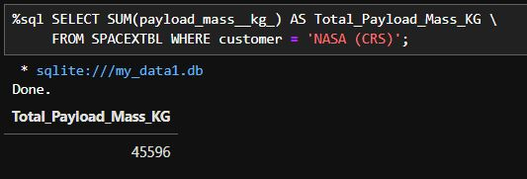
Total Payload Mass
We can get the total payload mass (45596 Kg) by using the ''SUM'' keyword.

Slide 27
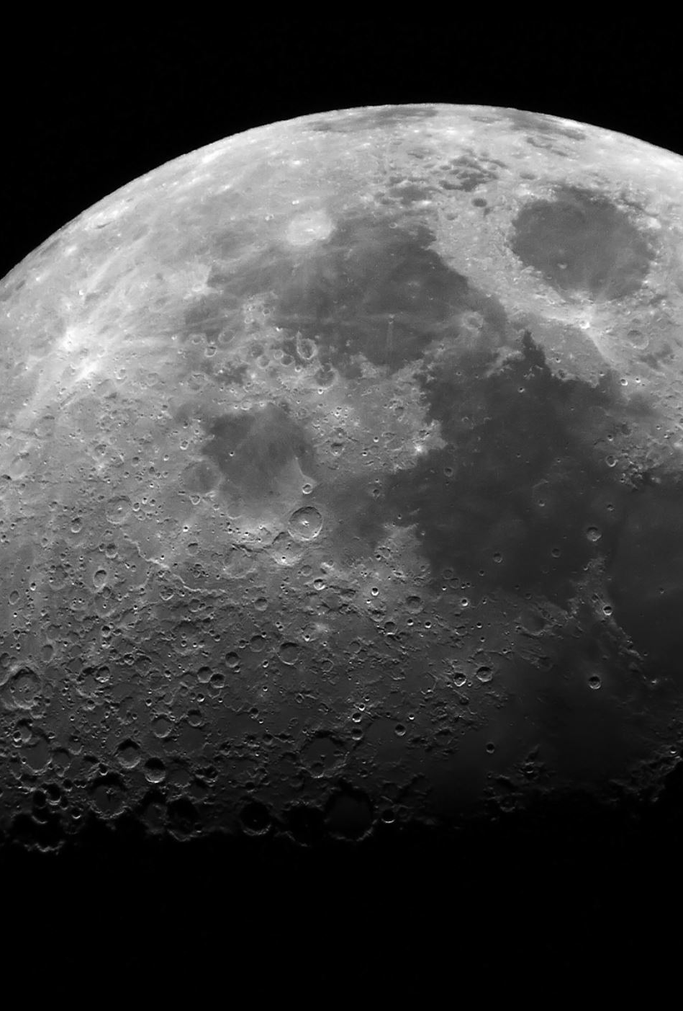
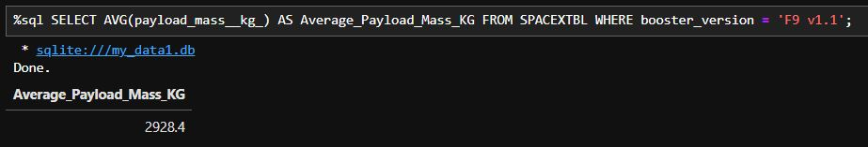
Average Payload Mass by F9 v1.1
We can get the average payload mass carried by booster version F9 v1.1 (2928.4 Kg) by using the ''AVG'' keyword.

Slide 28

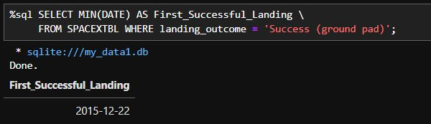
First Successful Ground Landing Date
We can get the first successful ground landing date (2015-12-22) by using the ''MIN'' keyword because the first date can be considered the minimum date.

Slide 29
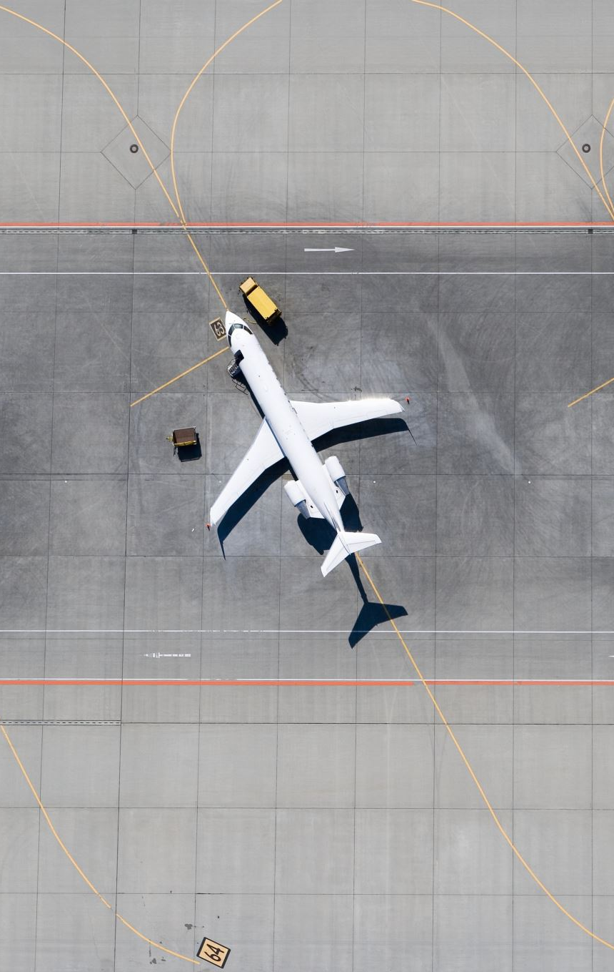
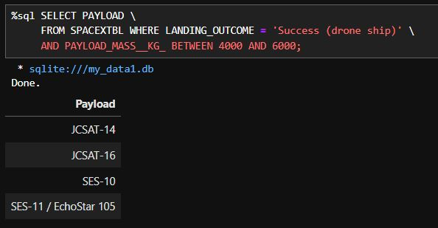
Successful Drone Ship Landing with Payload between 4000 and 6000
We can get the successful drone ship landing with payload between 4000 and 6000 (2015-12-22) by setting as the landing outcome ''Success (drone ship)''

Slide 30

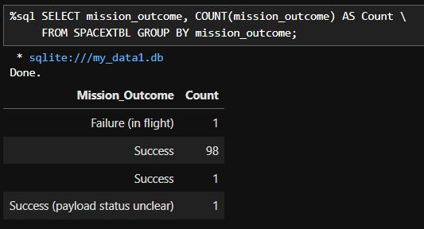
Total Number of Successful and Failure Mission Outcomes
We can get the total of successful and failure mission outcomes by using the ''COUNT'' keyword.

Slide 31
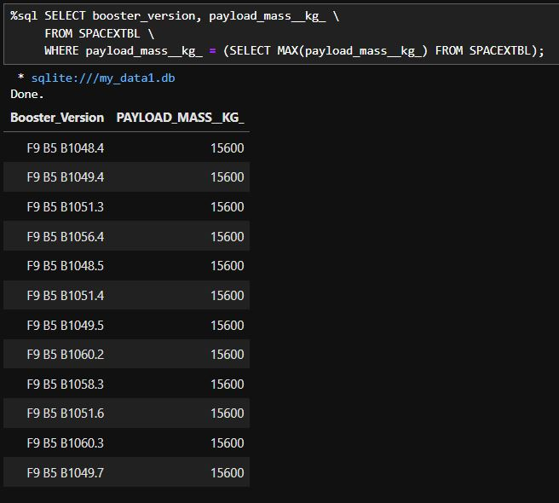
Boosters Carried Maximum Payload
We can get the boosters carried maximum payload (15600 Kg) by using the ''MAX'' keyword.

Slide 32

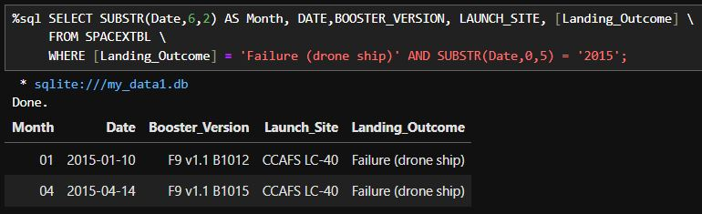
2015 Launch Records
We can get the 2015 launch records by using the ''SUBSTR'' keyword and in the ''WHERE‘’ function setting the year value to ''2015''.

Slide 33

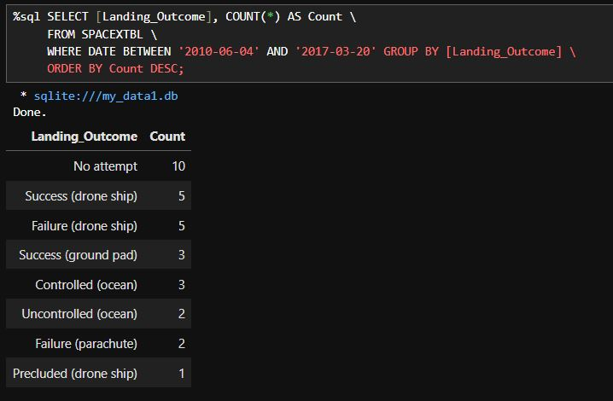
Rank Landing Outcomes Between 2010-06-04 and 2017-03-20
We can order the value in descending order by using the ''DESC‘’ keyword and display its count by using the ''COUNT‘’ keyword.

Slide 34

Section 3

Slide 35

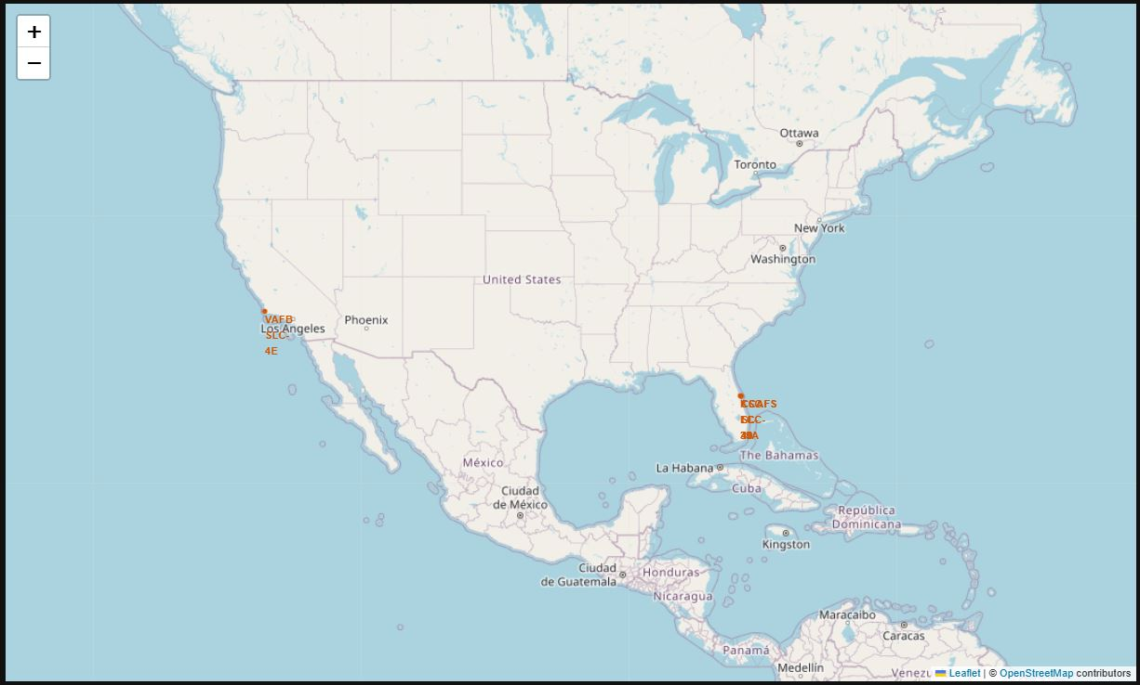
SpaceX Worldwide Launch Sites
SpaceX launch sites are located on the U.S. coasts of California and Florida.

Slide 36
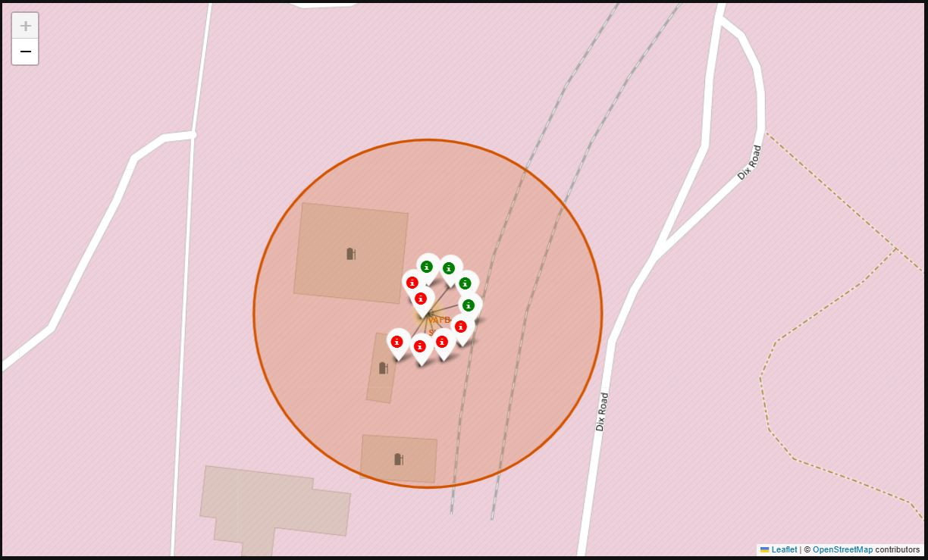
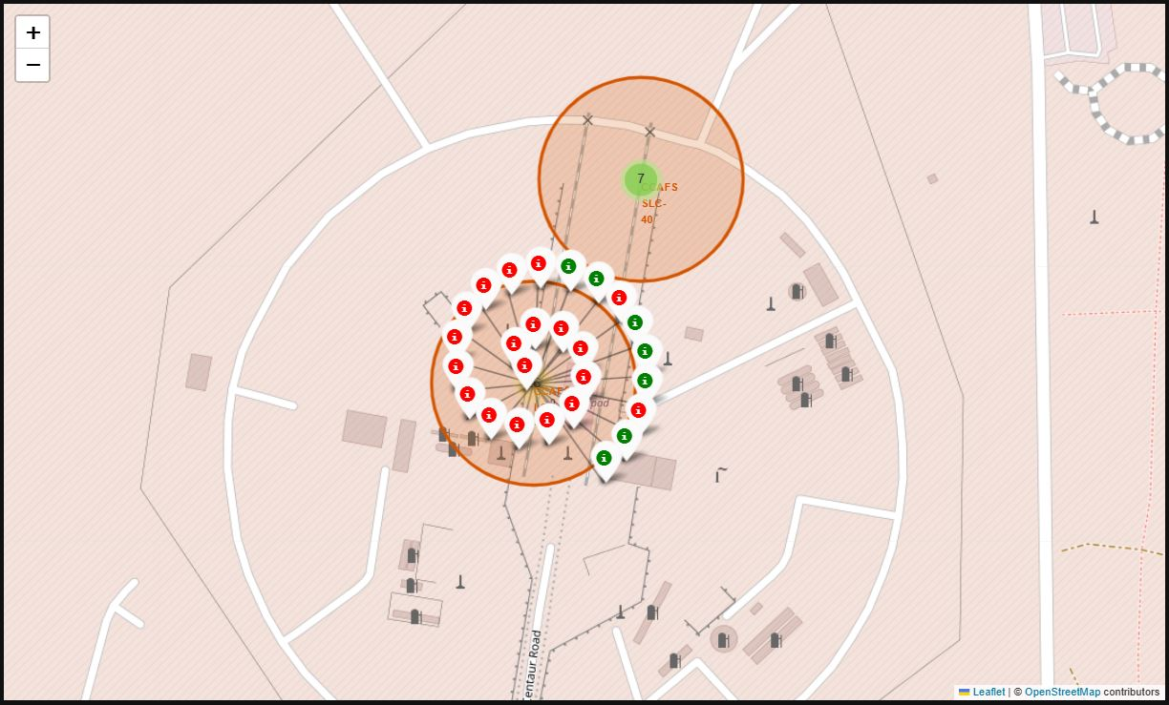
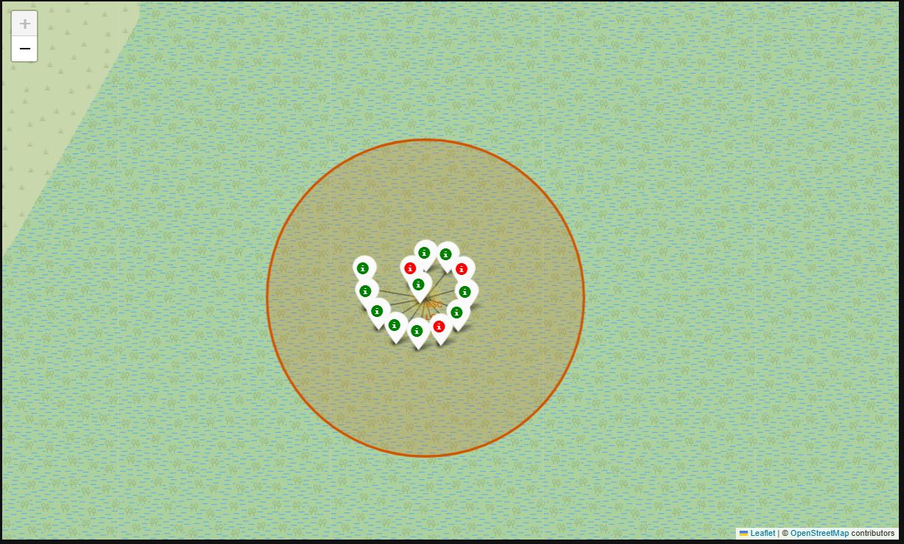
Launch Sites Map Markers
Map markers for the California and Florida launch sites are shown below.

Slide 37
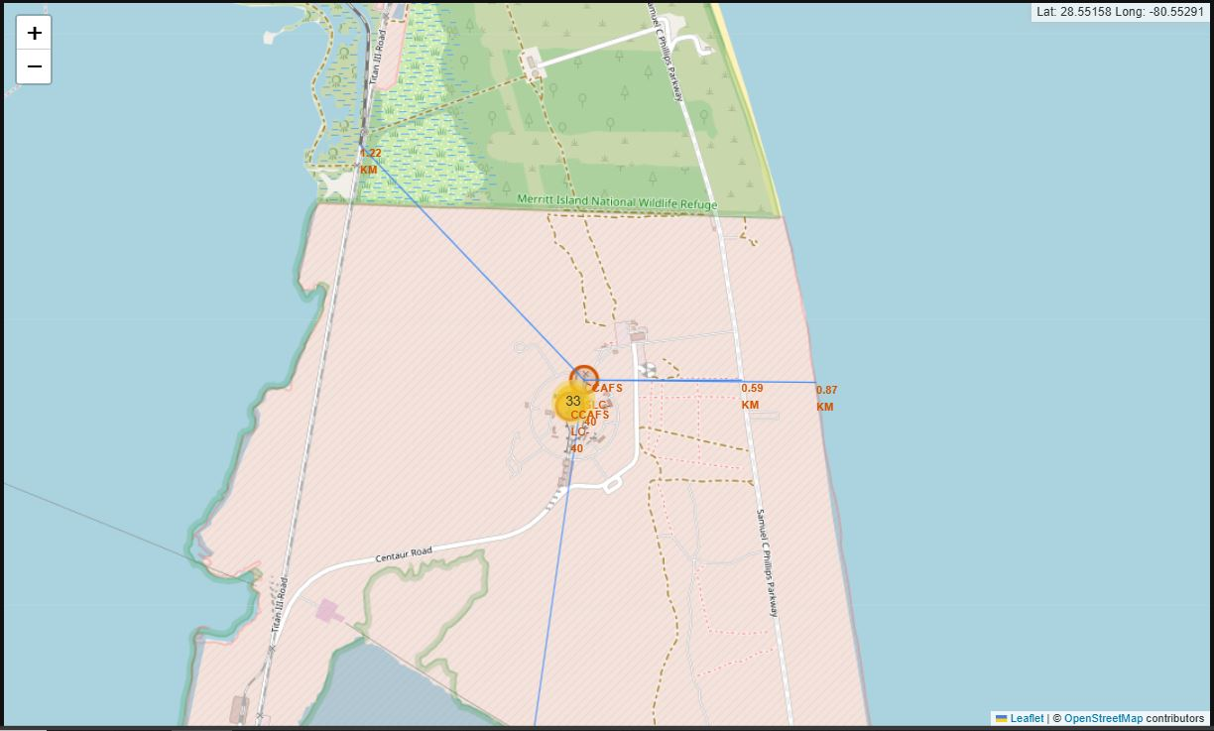
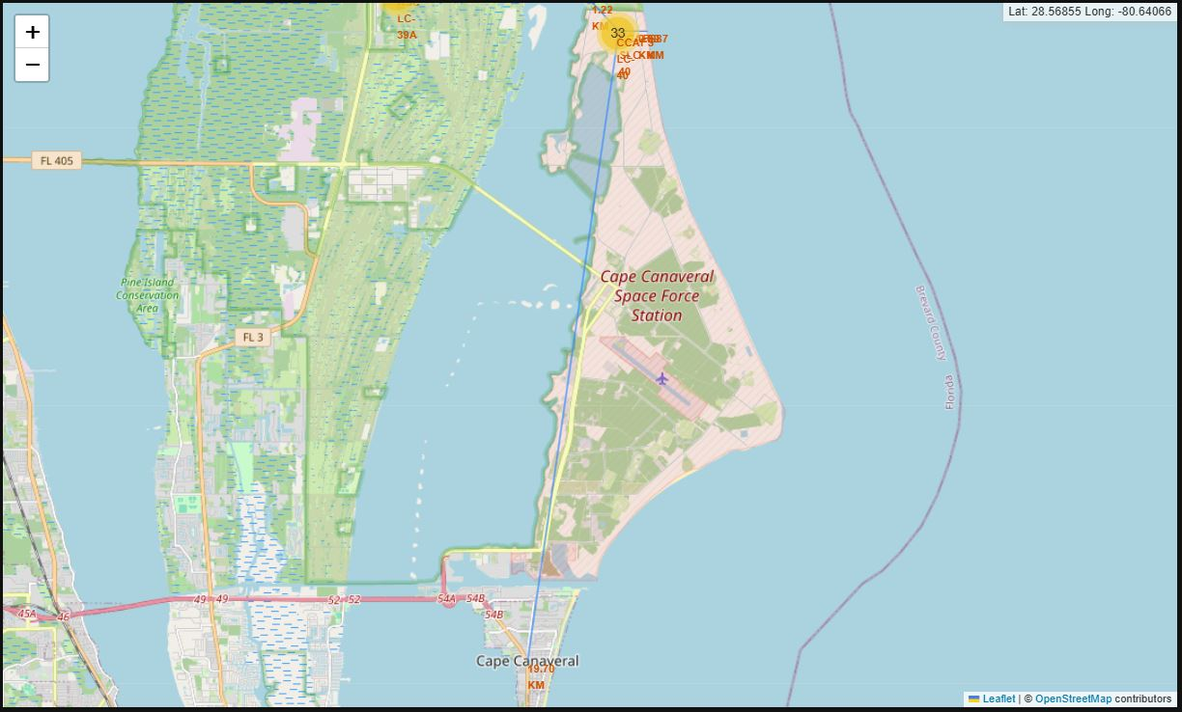
Distance between Launch Sites and Landmarks
Distance to closest coastline, highway, railway and city are shown below:

Slide 38

Section 4

Slide 39
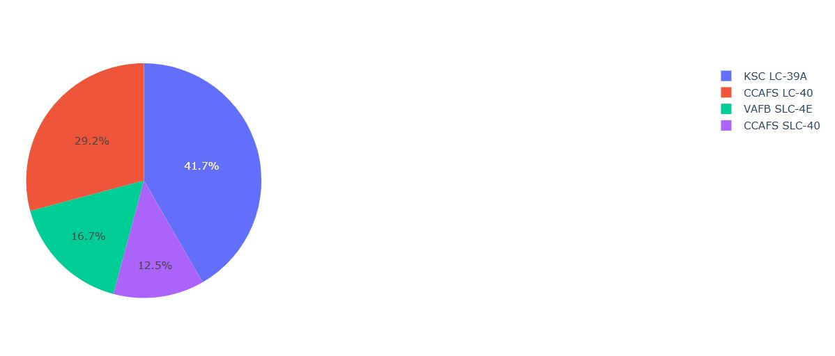
Total number of successful launches from each launch site.
KSC LC-39A has the highest success rate.

Slide 40
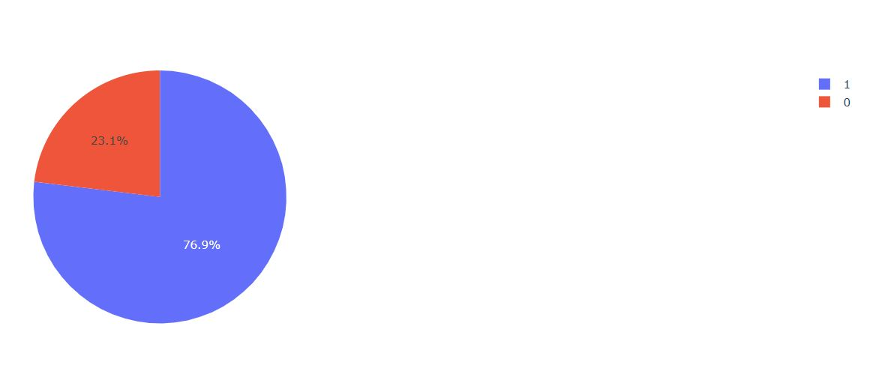
Launch site with the highest success rate
KSC LC-39A has a 76.9% success rate and only a 23.1% failure rate.

Slide 41
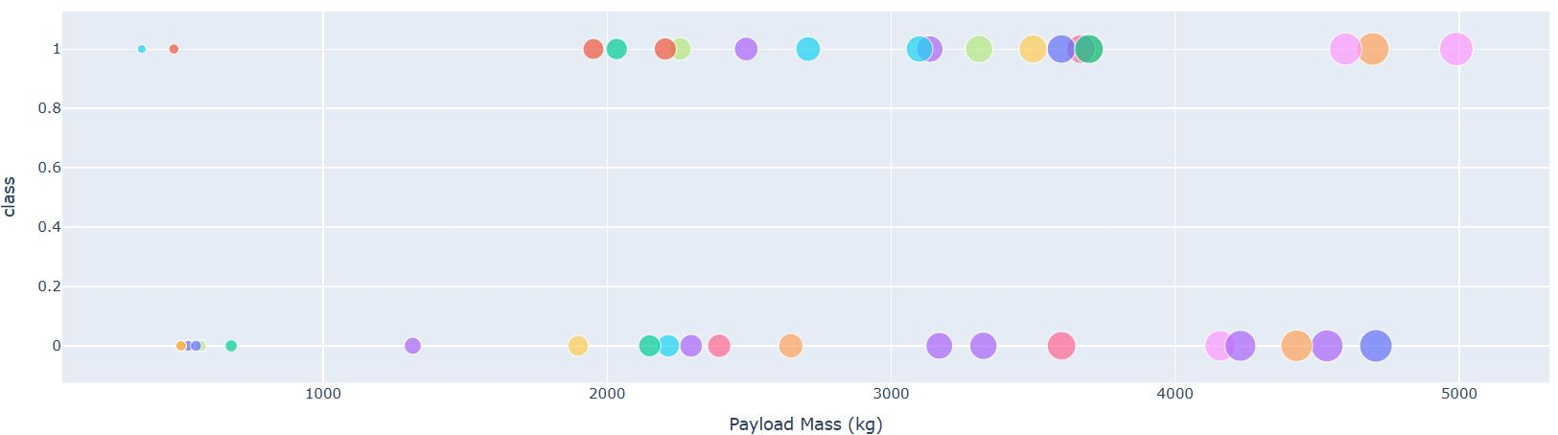
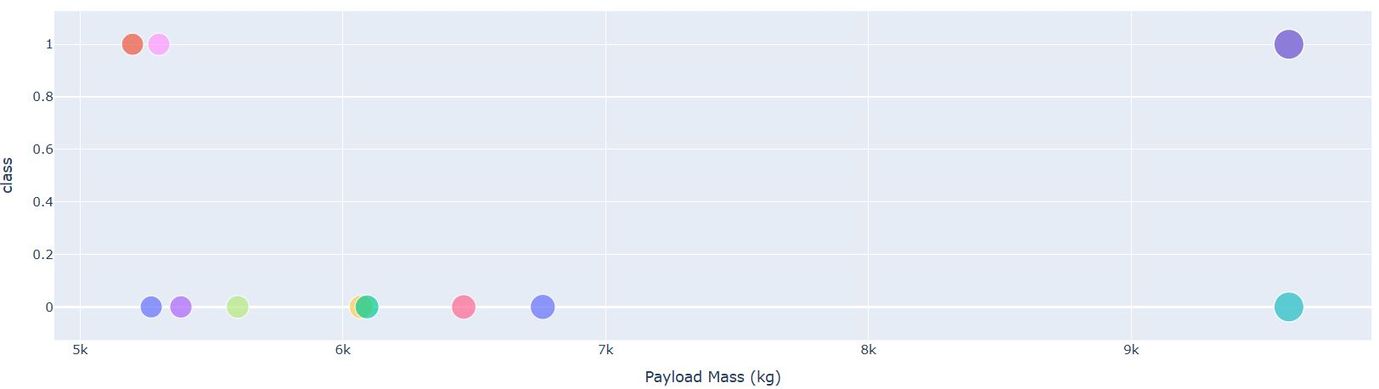
Scatter plot of Payload vs. Outcome for all sites, with different payloads.
The success rate is higher for lower payloads (0 to 5000 kg) than for heavier payloads (5000 to 10000 kg).

Slide 42

Section 5

Slide 43

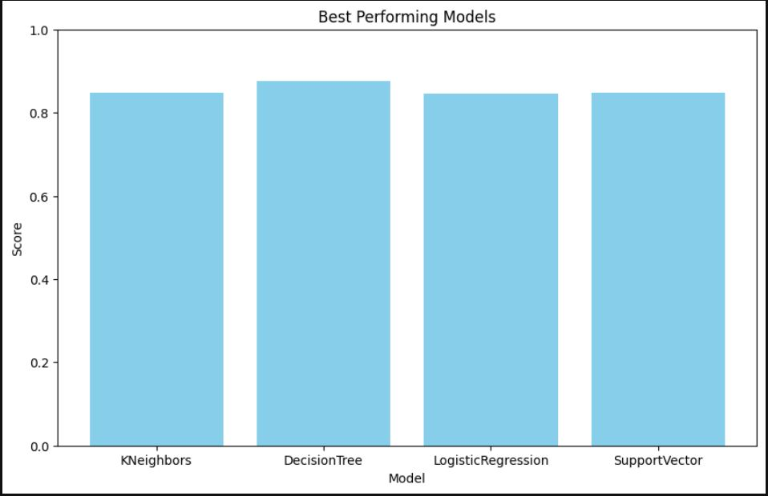
Classification Accuracy
Best model is DecisionTree with a score of 0.87

Slide 44
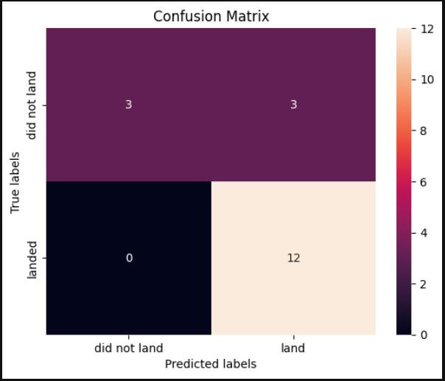
Confusion Matrix
The confusion matrix of the decision tree classifier clearly shows that it can differentiate between different classes, but it also shows an issue with false positive values.

Slide 45
Conclusions
Decision Tree is the best performing model.
The launch site with the highest success rate is KSC LC-39A
The launch success rate started to increase in 2013, reaching the highest rate in 2019.
The payload range from 0 to 5000 kg has a higher success rate than heavier payloads.
We have explained why it's better for launch sites to be near coastlines, highways, railroads and not located near populated areas.

Slide 46

Appendix
My GitHub repository with all the notebooks and python code for this project can be found at the following link:
davevad93/IBM-applied-data-science-capstone: IBM Data Science Professional Certificate final project (github.com)

Slide 47


